Slide 1

DW Assignment 2
Ong Sze Hwee alec
S10222628K

Slide 2
Table of Content
Objective Overview
Data Exploration (Visualizing each table)
Data Wrangling
Data Cleansing and transformation
Machine Learning Modelling

Slide 3
Objectives
Explore, extract and clean data from the given files to formulate a prediction problem
Creating tabular data which connects multiple tables to tackle the prediction problem
Prepare and transform, train and test data to build a machine learning model
Use findings from models and visuals to find solutions for the prediction problem

Slide 4
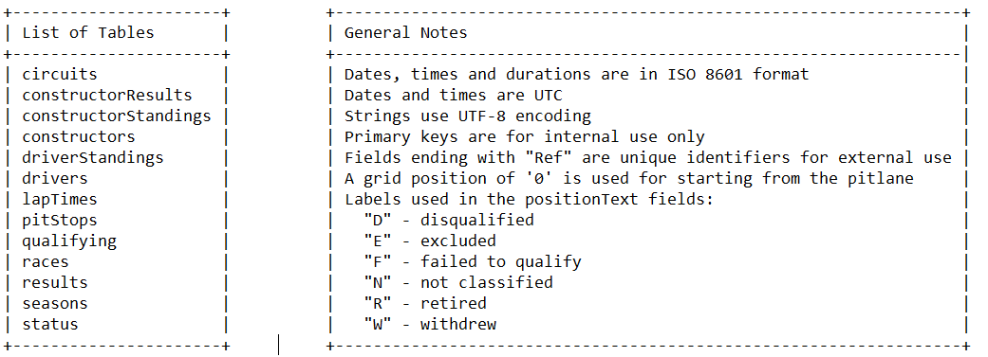
Exploring the Data
with Given Data Dictionary

Slide 5
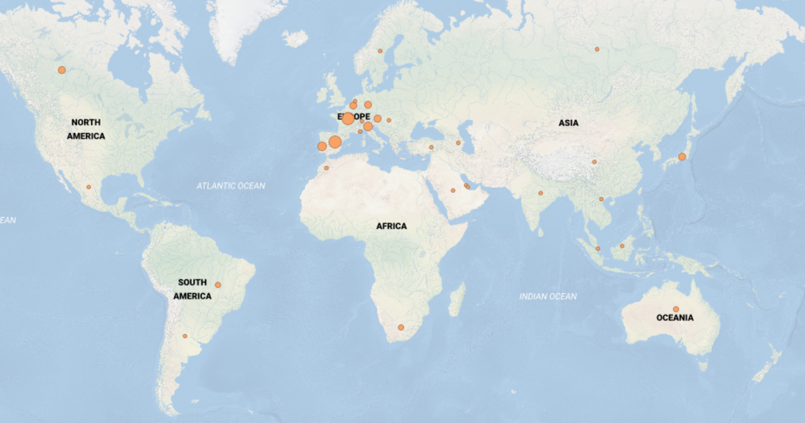
Map Chart
Circuit_Mod
Most circuits in Europe
Quite spread out in most regions
Lacking in Central Africa and Asia
Notes:
This map chart shows us where each circuit is held
We can see that there is a large amount of circuit within the Europe area

Slide 6
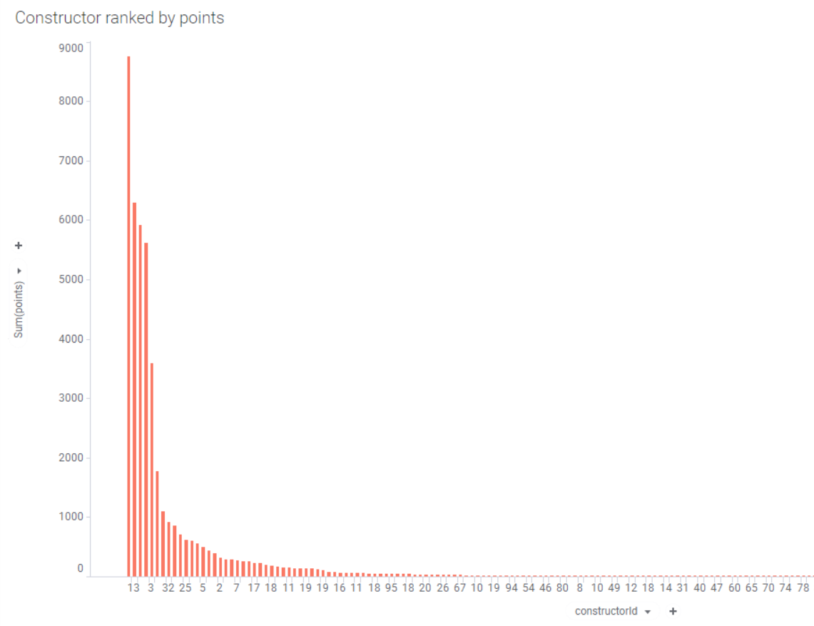
Constructor ranked by points
Constructor_results_Mod
Big difference in points between High and Low performing constructors
Top Constructor has significant higher point

Slide 7
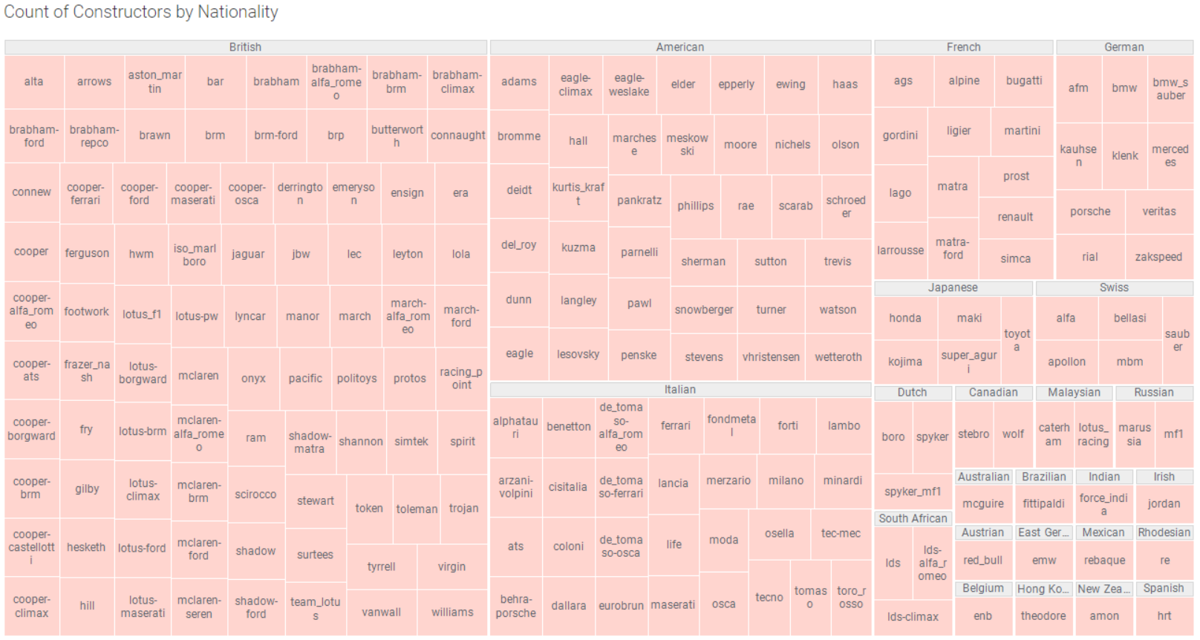
Constructor Count by Nationality
Constructors__Mod
British has the highest number of Constructors
Spanish has the least
British, America and Italian sum up to more than half of the constructors

Slide 8
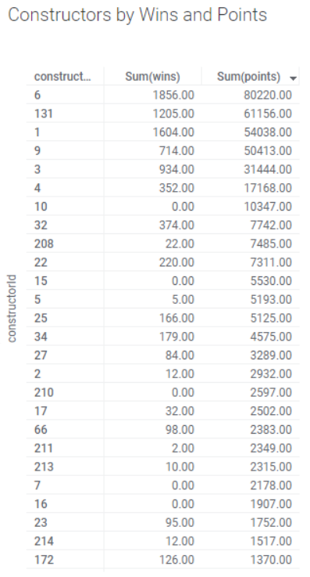
Constructor by Wins and Points
Constructors_Standings__Mod
Top scoring constructors also have hight amount of wins
Exceptions being 10 and 15 where it has 0 wins but still a relatively high amount of points
Notes:
Shows the total amount of wins and points scored by each constructors
Ranked from highest to lowest points

Slide 9
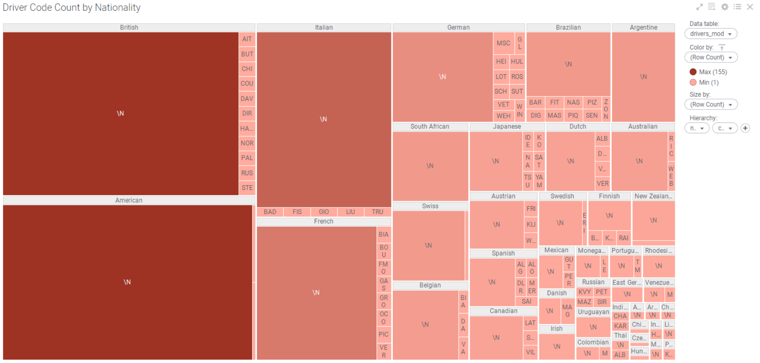
Driver Code Count by Nationality
Drivers_Mod
British and America has very high Driver counts
Most Driver does not have a code hence “\N”
Most drivers are British, American, Italian and French
Notes:
Shows which nationality hosts the highest number of drivers

Slide 10
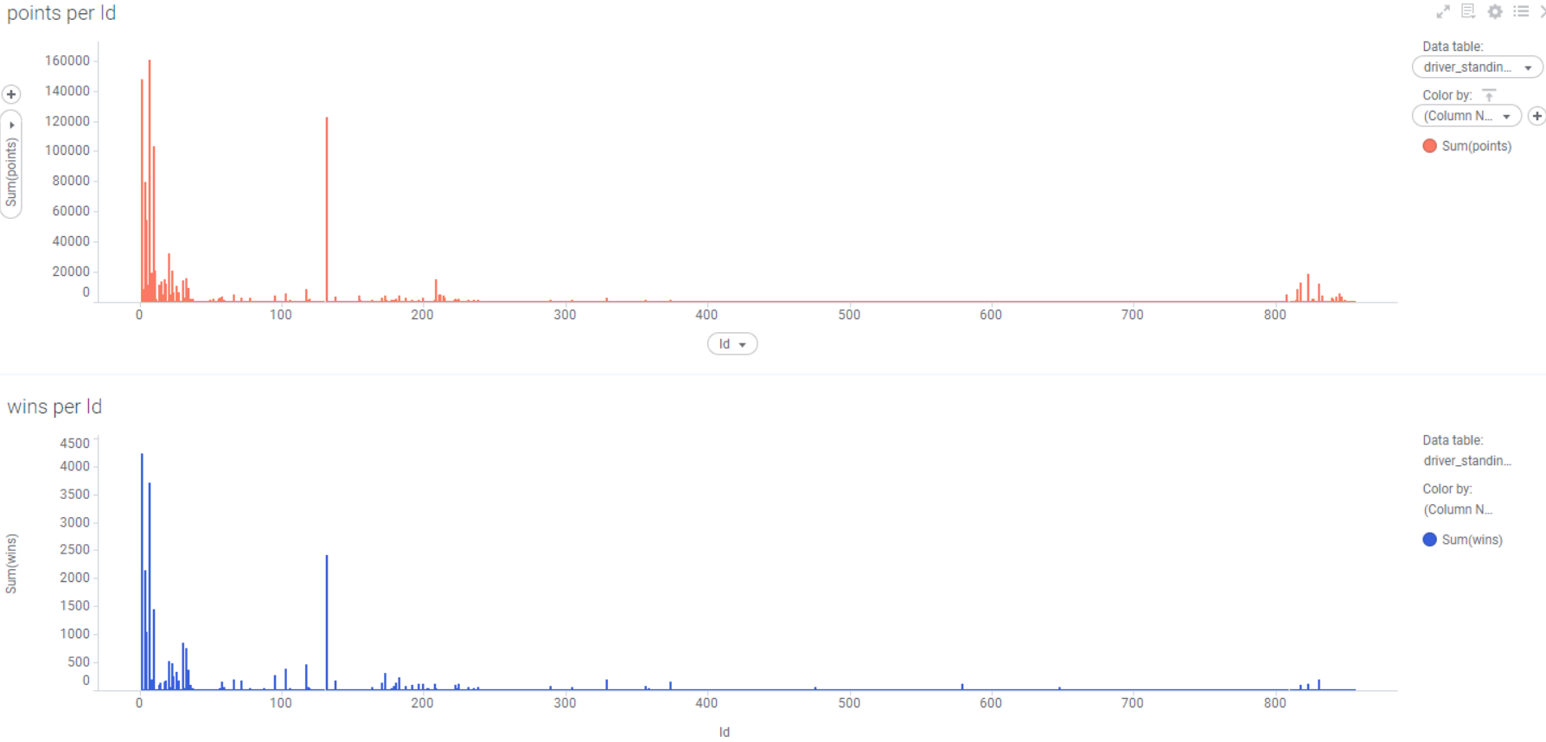
Wins and Points Per DriverID
Drivers_Standings_Mod
Only a small group of similar drivers have high wins and points
Drivers who have high points also shows high wins
Outstanding drivers have large difference compared to lesser performing drivers
Notes:
Shows the total number of points and wins earned by each driver, we can see that only
A small amount of drivers are doing exceptionally better than the rest

Slide 11
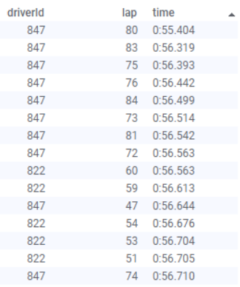
DriverID by lap and time
Lap_Time_Mod
Tabulated drivers to their lap time
Can see that “847” has consistently fastest lap time along with “822”
The fastest is 0:55 with the rest being 0:56 in the top 10
Notes:
We can see which driver has the fastest lap time

Slide 12
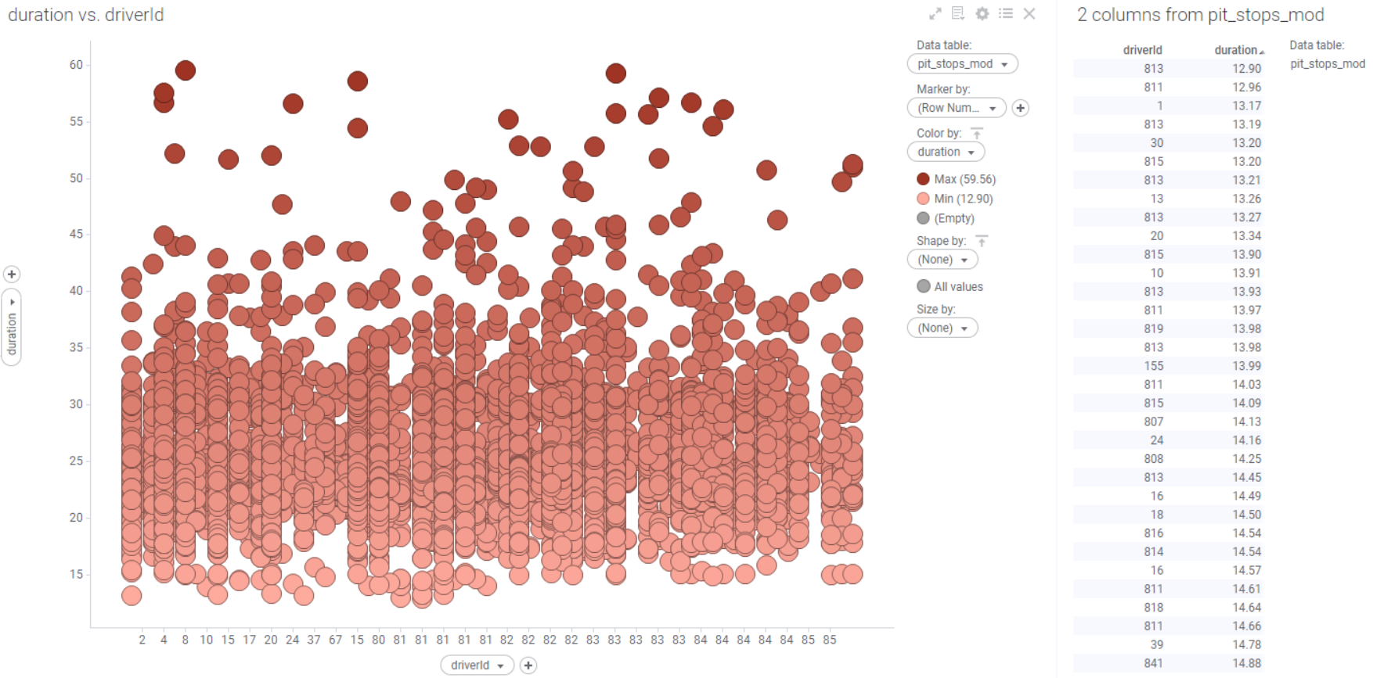
DriverID by pitstop duration
Pit_Stops_Mod
Scatterplot shows r/s between durations and each driver
Most pitstops duration are below 35 sec
Shortest pitstop is 12.90 sec
given to “813”
Notes:
The scatterplot shows the relationship between each driver and their pitstop durations
While the table beside ranks the drivers with the lowest pitstops duration

Slide 13
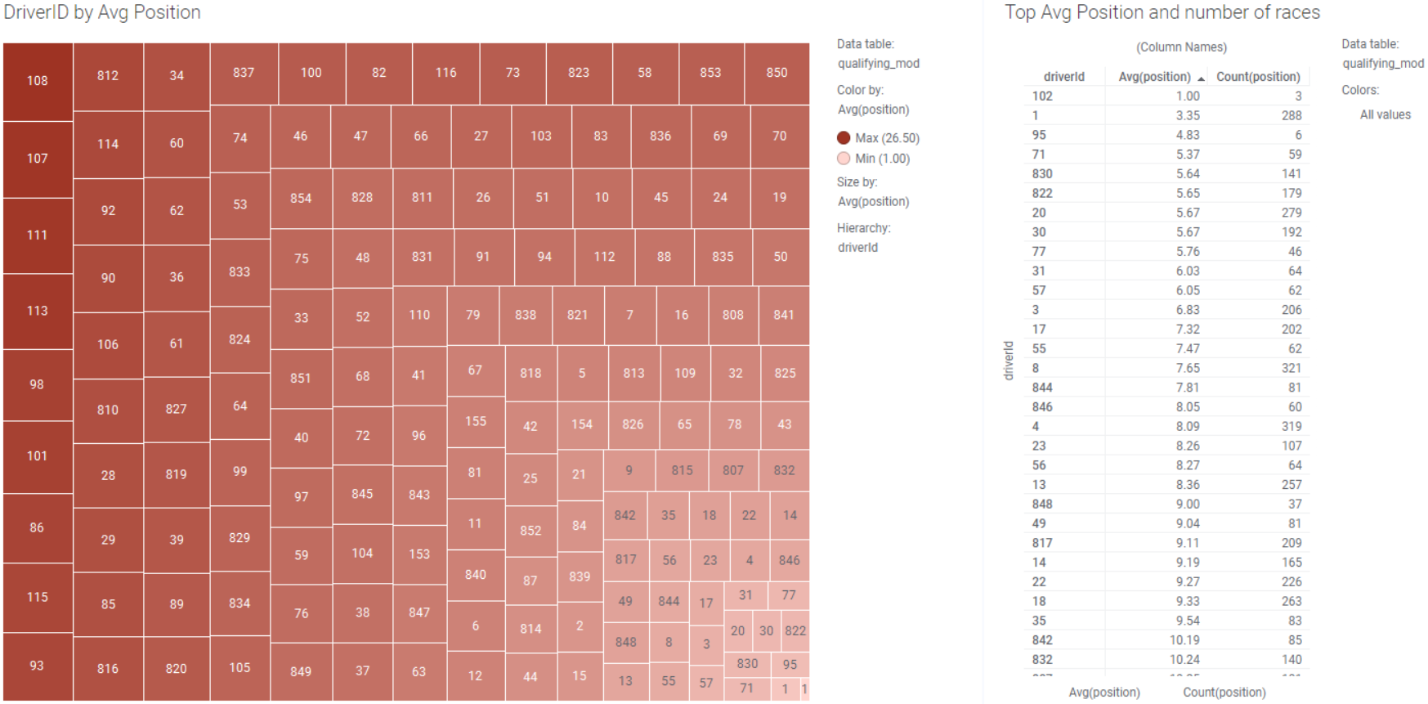
DriverID by Avg Position and Race Count
Qualifying_Mod
“108” has the worst performance in terms of Avg Position
“102” has the best Avg Position of 1 but only have 3 races
Overall best performing should be “1” with low position and high races
Notes:
The heat map shows how each driver is doing by their average position for all their races
While the table shows the top ranking average position while also showing how many races they have been in using Count

Slide 14
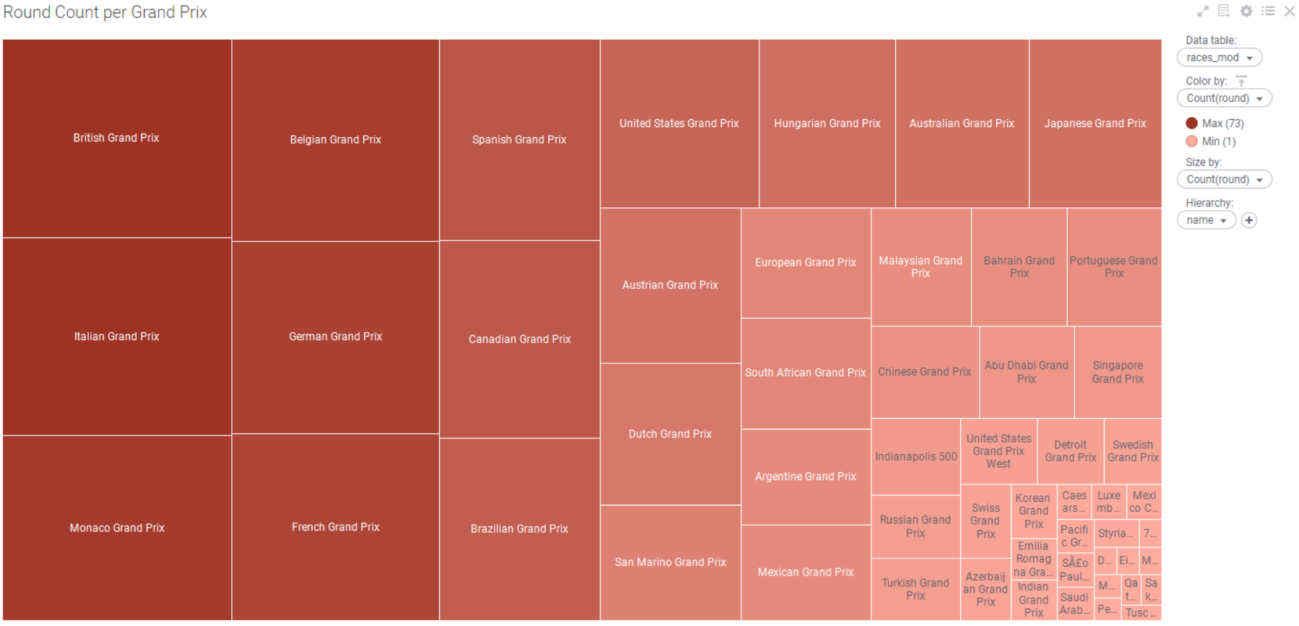
Grand Prix by Rounds
Races_Mod
Shows the total count each time the Grand Prix has been used yearly
British/ Italian has the highest usage with 73 yearly usages
Shows popularity between each grand prix
Notes:
This shows which grand prix has the highest number of years used or has the most times used to host rounds

Slide 15
After visualizing with Tibco
Inner join/Connect tables with Common Race, Driver, Constructor ID
Ranking time takes the lowest values and are a good measure of effectiveness
Status table explains the status ID found in Results table

Slide 16
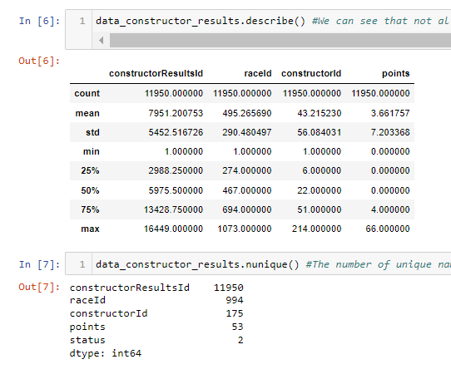
Exploring Data through Jupyter Notebook
Constructor_results_mod

Slide 17
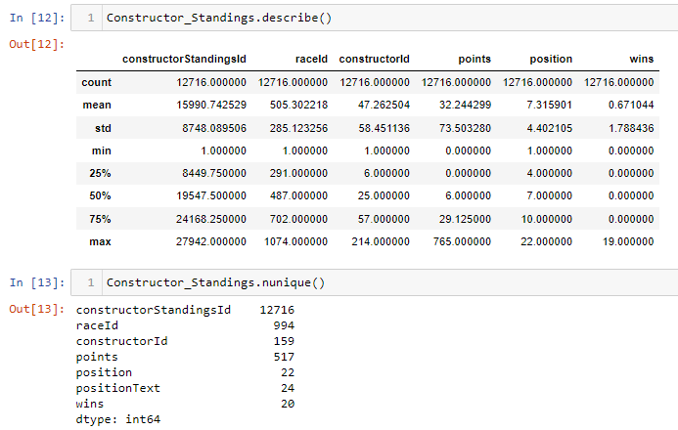
Exploring Data through Jupyter Notebook
Constructor_Standings_Mod

Slide 18
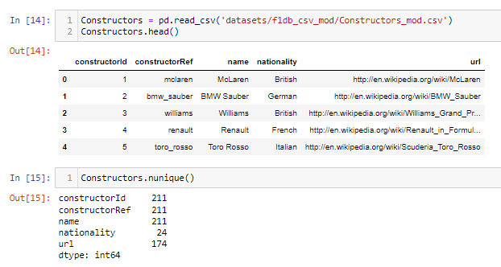
Exploring Data through Jupyter Notebook
Constructors_mod

Slide 19
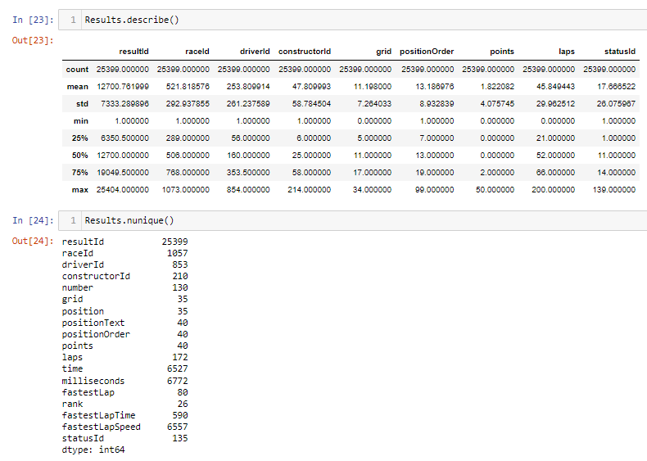
Exploring Data through Jupyter Notebook
results_mod

Slide 20
Formulated Prediction Problem
Formulating predictions for
- ConstructorID
To predict the first 10 constructors position in terms of
- Position Order
While basing on other variables such as
- Grid
- Milliseconds
- Fastest Lap Time and Speed
- Points and Wins
Tables to link through ConstructorID:
Constructor_results_mods, Constructor_standings_mod, Constructors_Mods and Results_Mods

Slide 21
Data Wrangling
Joining tables, new calculated columns, creating features using jupyter notebook

Slide 22
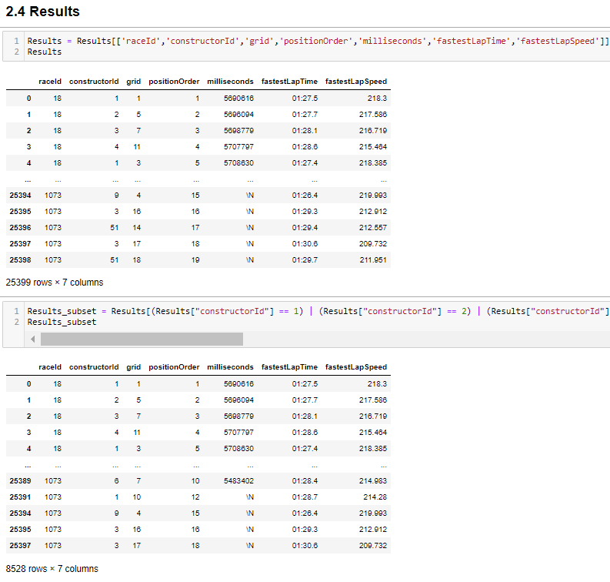
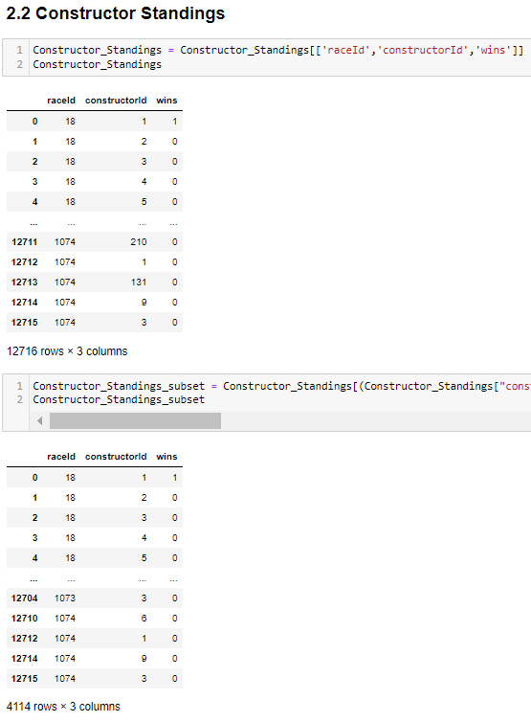
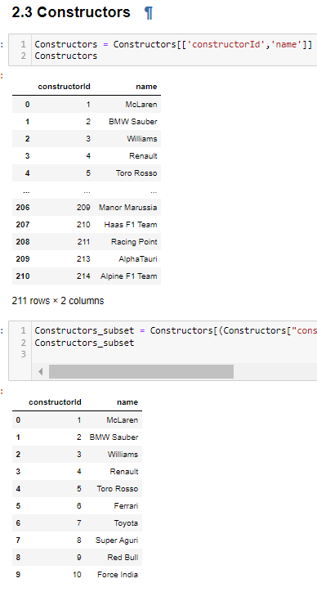
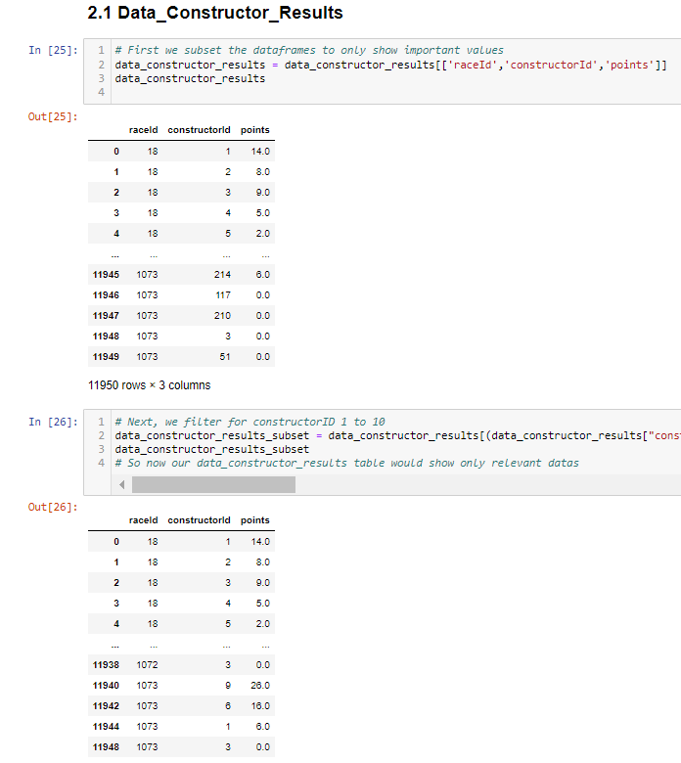
Subsetting and Filtering
Subset only the important and relevant values from each dataset
Filtered out ConstructorId 1 to 10

Slide 23
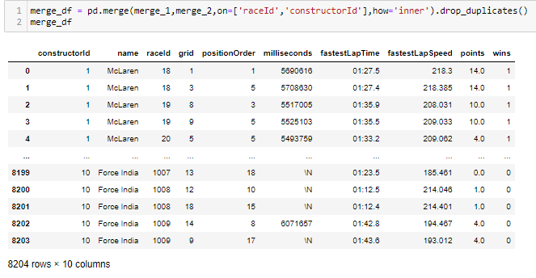
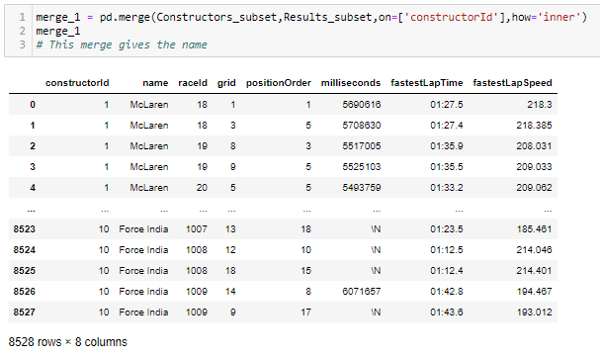
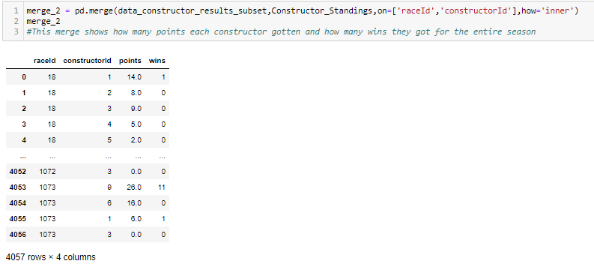
Merging and Joining
Inner join to only keep data consistency
Merge 1 = Constructor + Results
Merge 2 = Constructor_Results + Constructor_Standsings
Merge 3 = Merge 1 + Merge 2

Slide 24
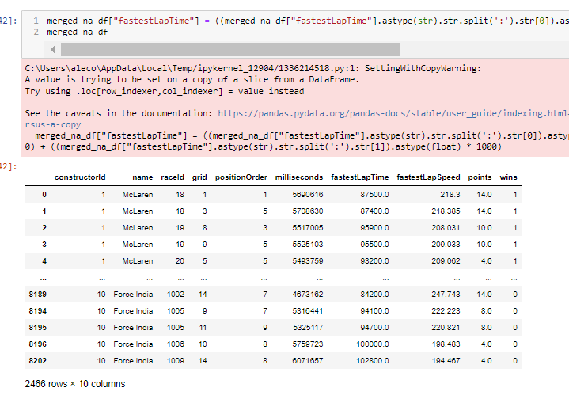
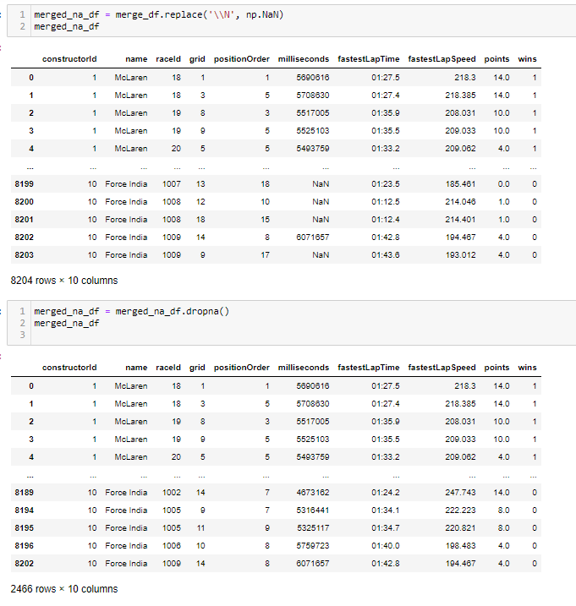
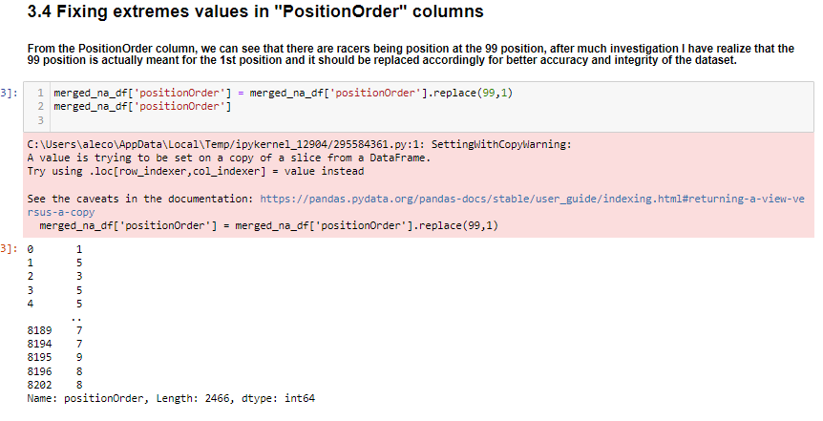
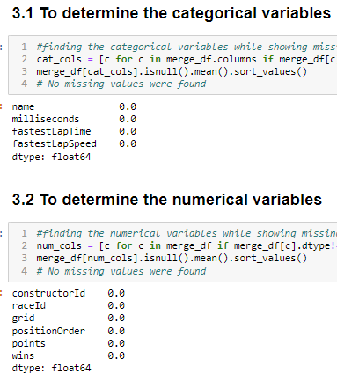
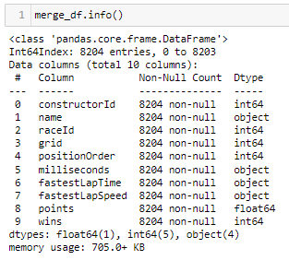
Merged Data exploration and cleaning
Important to clean the merged data before using it
Show Categorical and Numerical Data
Removal of \N values
Standardizing “fastestLapTime”
Replacing Extreme Values

Slide 25
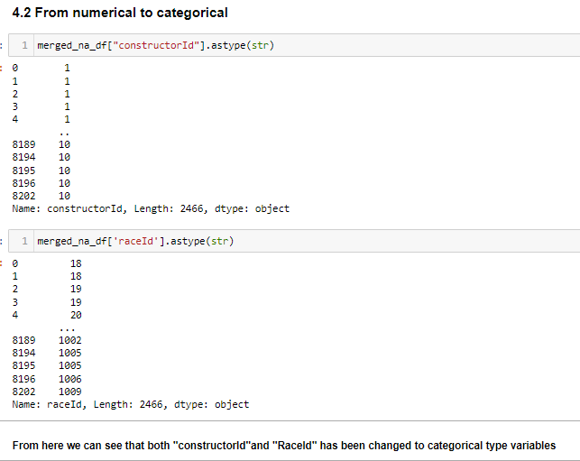
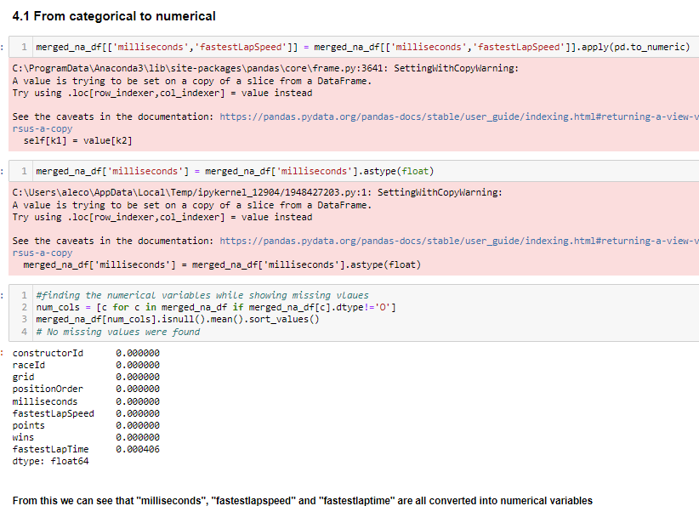
Additional Cleaning
Changing of Variables roles
From categorical to numerical
From numerical to categorical

Slide 26
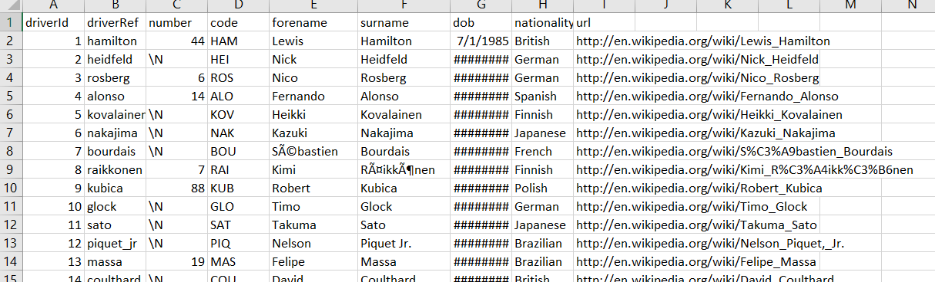
Data Cleaning
Of inconsistent and improper data values From Excel

Slide 27
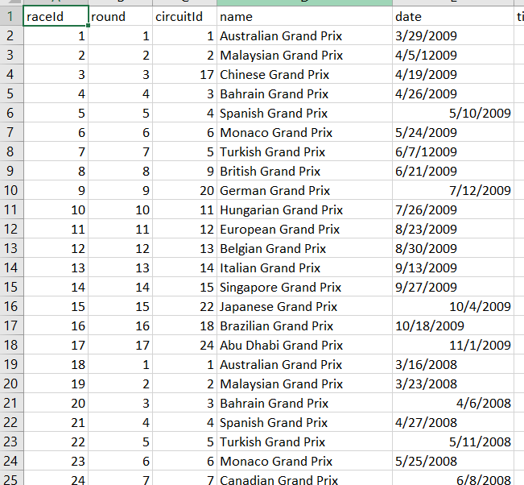
Races_Mod
Inconsistent Date Column
Formatted as general or date
Change all to dates

Slide 28
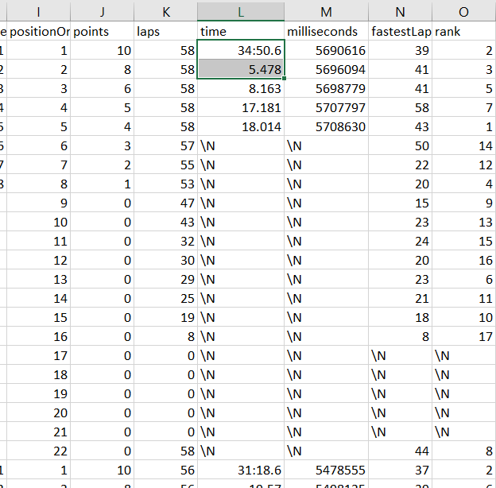
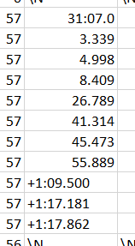
Results_Mod
Inconsistent time column values
Showing time with “:” separators or having “+” in front
Having time in just flat amount up to 3 d.p
Replace all with exact time with “:”

Slide 29
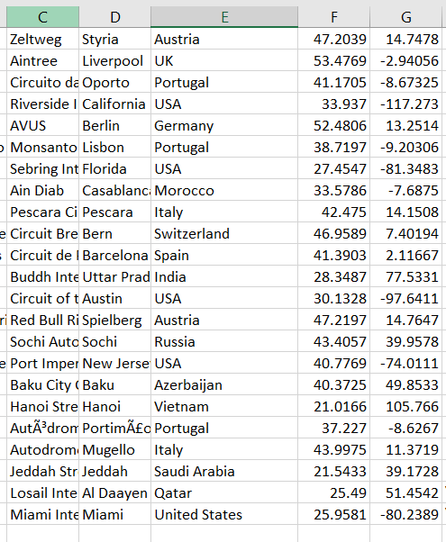
Circuit_Mods
Inconsistent values in Country Column
“USA” and “United States” are both used when they mean similar country
Change all “United States” values to “USA”

Slide 30
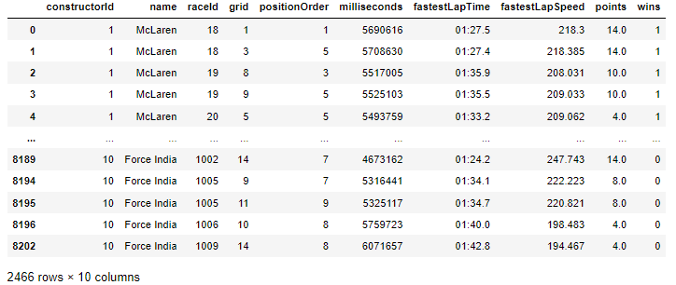
Data Cleaning and Transformation
Of Merged data values for modelling

Slide 31
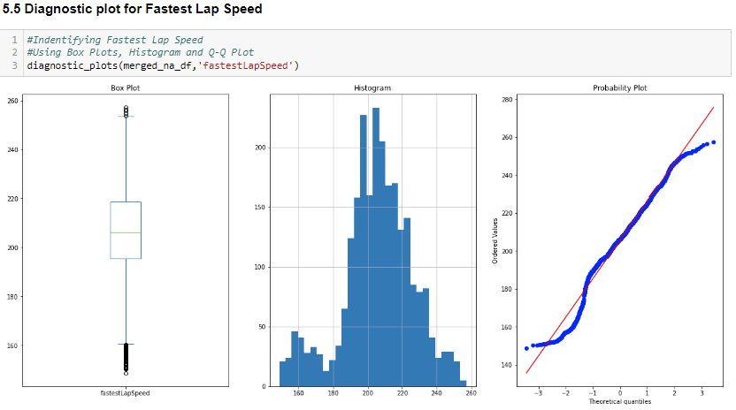
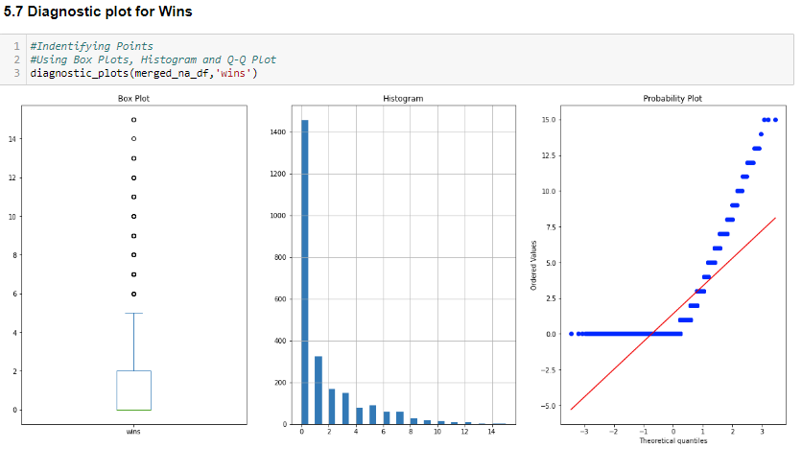
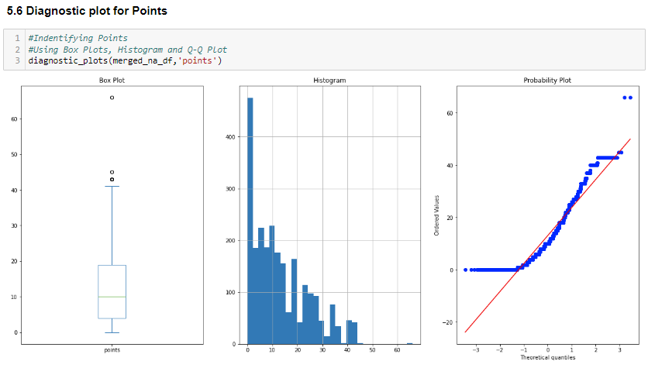
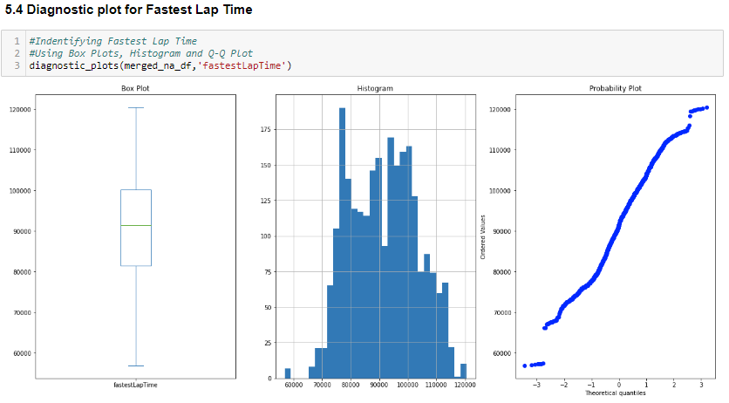
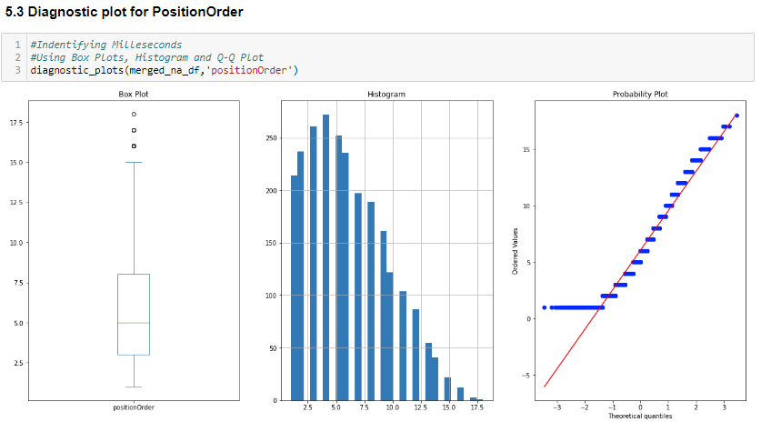
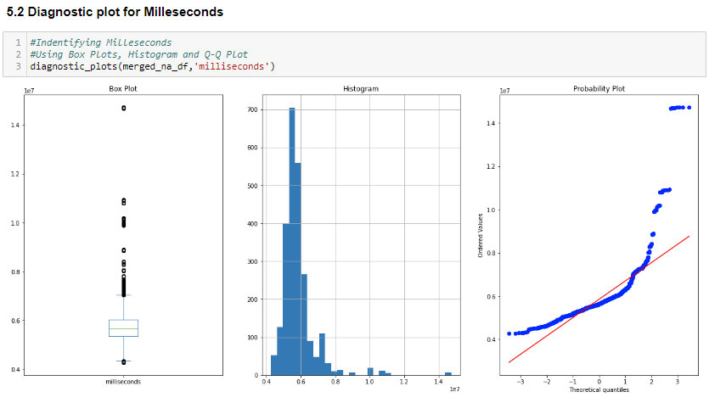
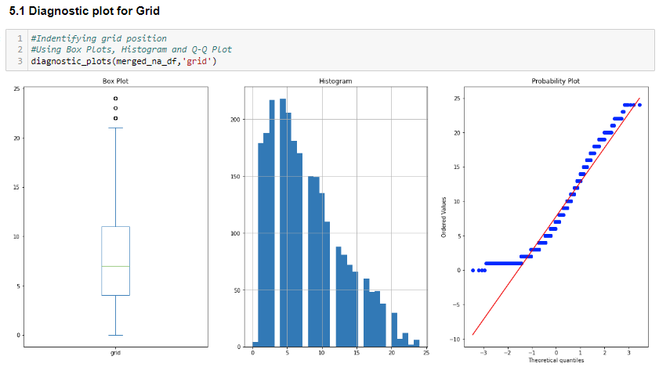
Identifying Outliers
Identified the significant outliers presented in:
- Milliseconds
- FastestLapSpeed

Slide 32
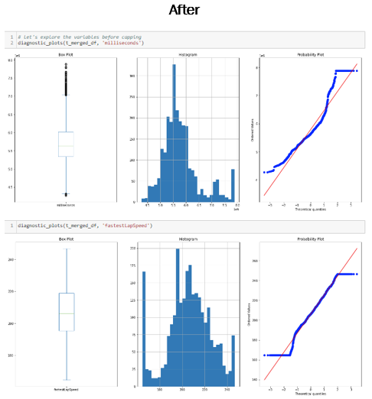
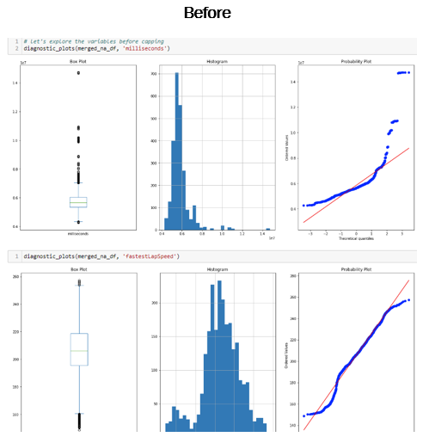
Dealing with Outliers
Methods Considered:
- Removal
- Capping
- Doing nothing
By using capping, we can preserve the outliers as the extreme values are still valid data

Slide 33
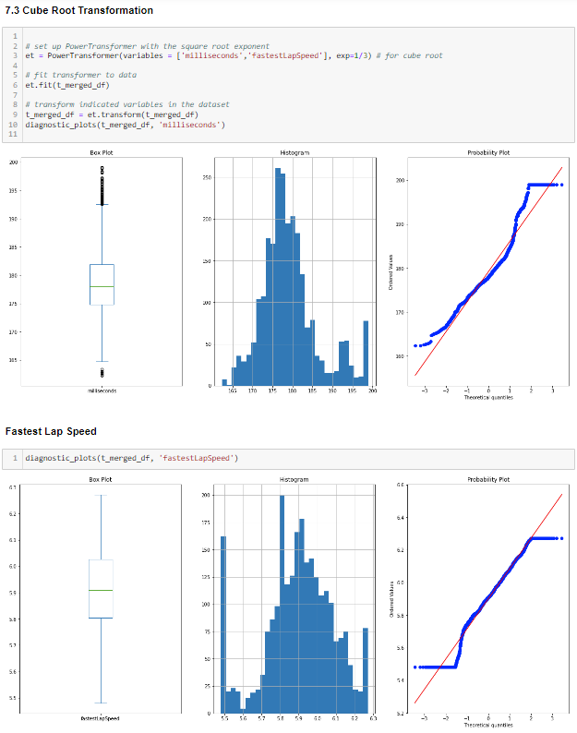
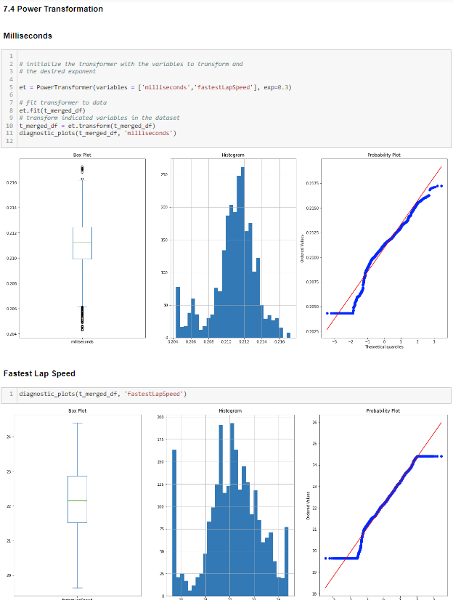
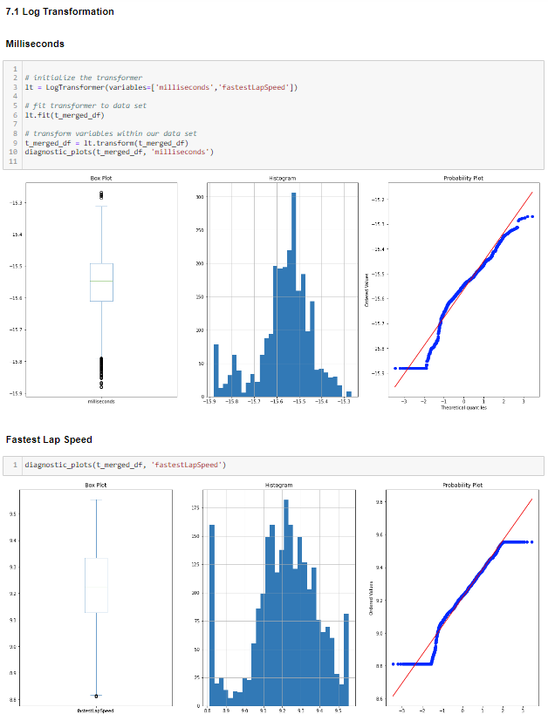
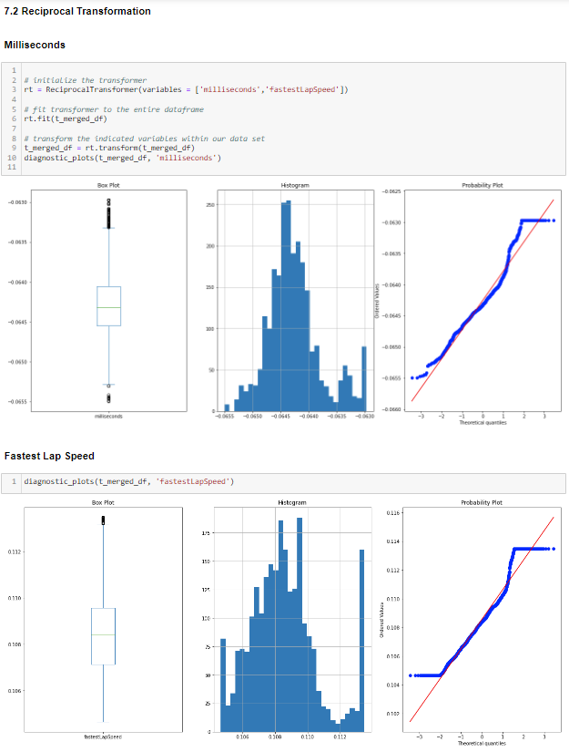
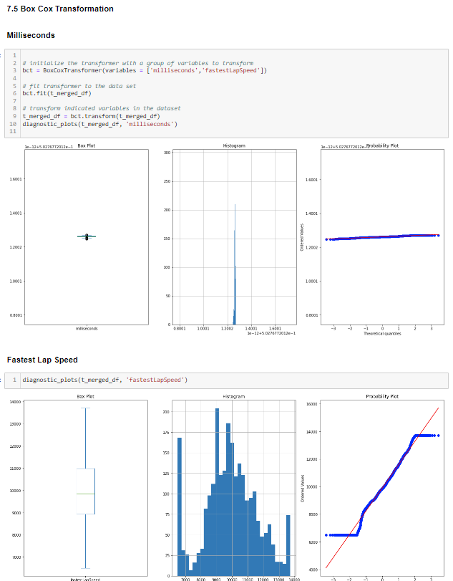
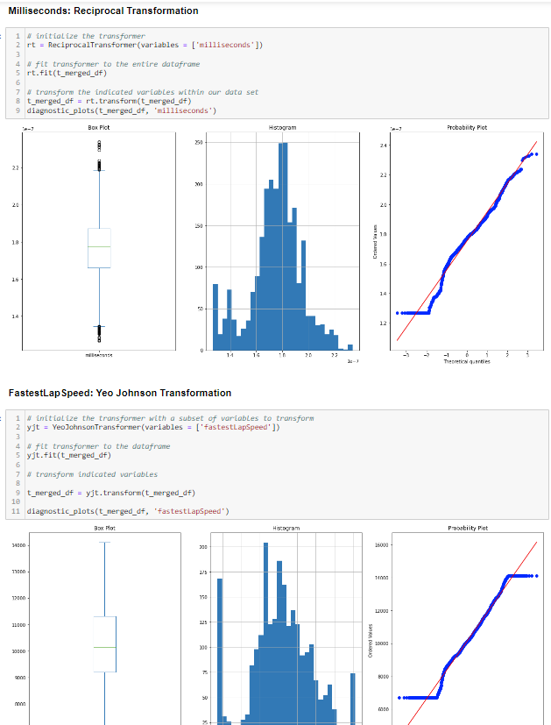

Numerical Variables Transformation
To Transform “Milliseconds” and “FastestLapSpeed” respectively
Chosen methods:
Milliseconds - Reciprocal Transformation
FastestLapSpeed – Yeo Johnson Transformation

Slide 34

Train Test Split

Slide 35





Numerical Variable Imputation
To deal with the missing values within “fastestLapTime”
Methods used:
- Mean median imputation(Chosen)
- Arbitrary -1 replacement
- Replacing values by end values
- Add missing indicator
- Random sample imputation

Slide 36



Categorical Data Encoding
To turn the categorical into numerical data that can be recognised by the computer
Method used:
- One hot encoding w/o top categories(chosen)
- Replace with Ordinal number-
- Replace with observation counts (Not valid)
- Ordered ordinal, Target mean and Rare category encoding (Not valid)

Slide 37






Variable Discretization
To bin each of the numerical variables
- Milliseconds
- fastestLapTime
- fastestLapSpeed
- Points
- Wins

Slide 38










Featured Engineering (Scaling)
Method used:
- Standardization
- Mean Normalization
- Min-Max Scaling
- Maximum Absolute Scaling
- Robust Scaling

Slide 39

Machine learning Modelling
Use the tabular data joined and merged in Step “Data Wrangling”
Use tutorial 11 – Iris Naïve Baseline modelling to simulate a low functioning dataset
Use Assignment 1 steps in doing a linear regression model to test integrity of tabular data

Slide 40

Optimisation for Machine Learning Model
Choosing those methods that optimizes the RMSE and R-SQ values
Final outcome:
Method used:
Reciprocal + Yeo Johnson | Mean Median Imputation |One Hot Encoding for Top Categories|
Equal Width Distribution | Robust Scaling
For RMSE: We would want the value to be as low as possible.
For R-SQ: We would want to avoid negative values while also keeping it as close to 1 as possible

Slide 41


RMSE & R-SQ Comparison
My Model
Naïve Baseline

Slide 42

Recommendations
Better standardization of Data
Having higher functioning datasets
Additional valuable variables for modelling

Slide 43
Thank You!

